Slide 1

Session 2: Q&A

Slide 2

What are the different varieties of plants?

Slide 3
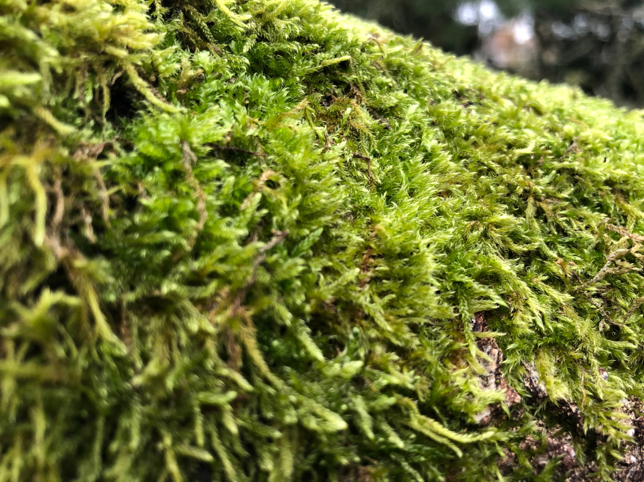
Mosses (Bryophytes)
No leaves, no flowers, no seeds

Slide 4
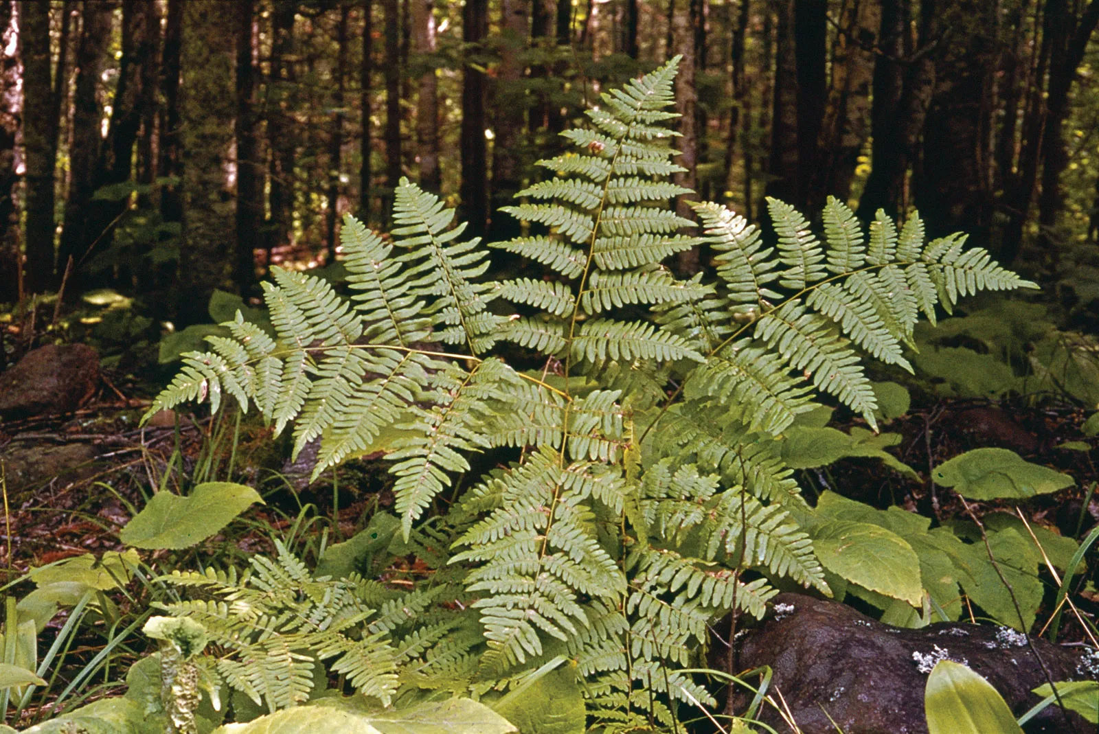
Ferns (Pteridophytes)
Have root, leaf and stem systems – no flowers

Slide 5
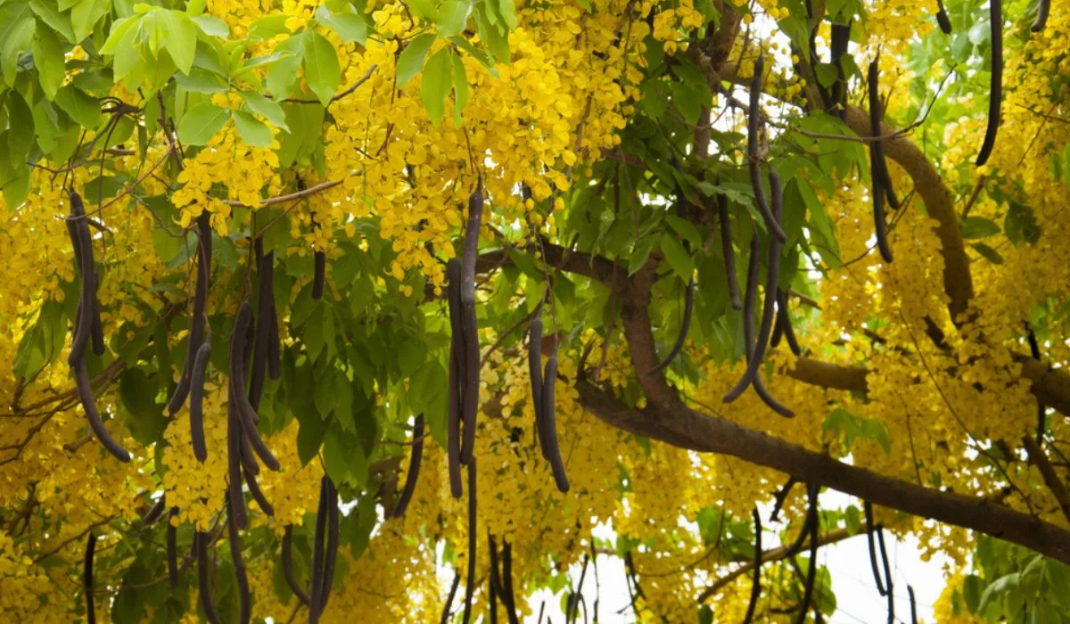
Flowering plants (Angiosperms)
Produce flowers and seeds

Slide 6
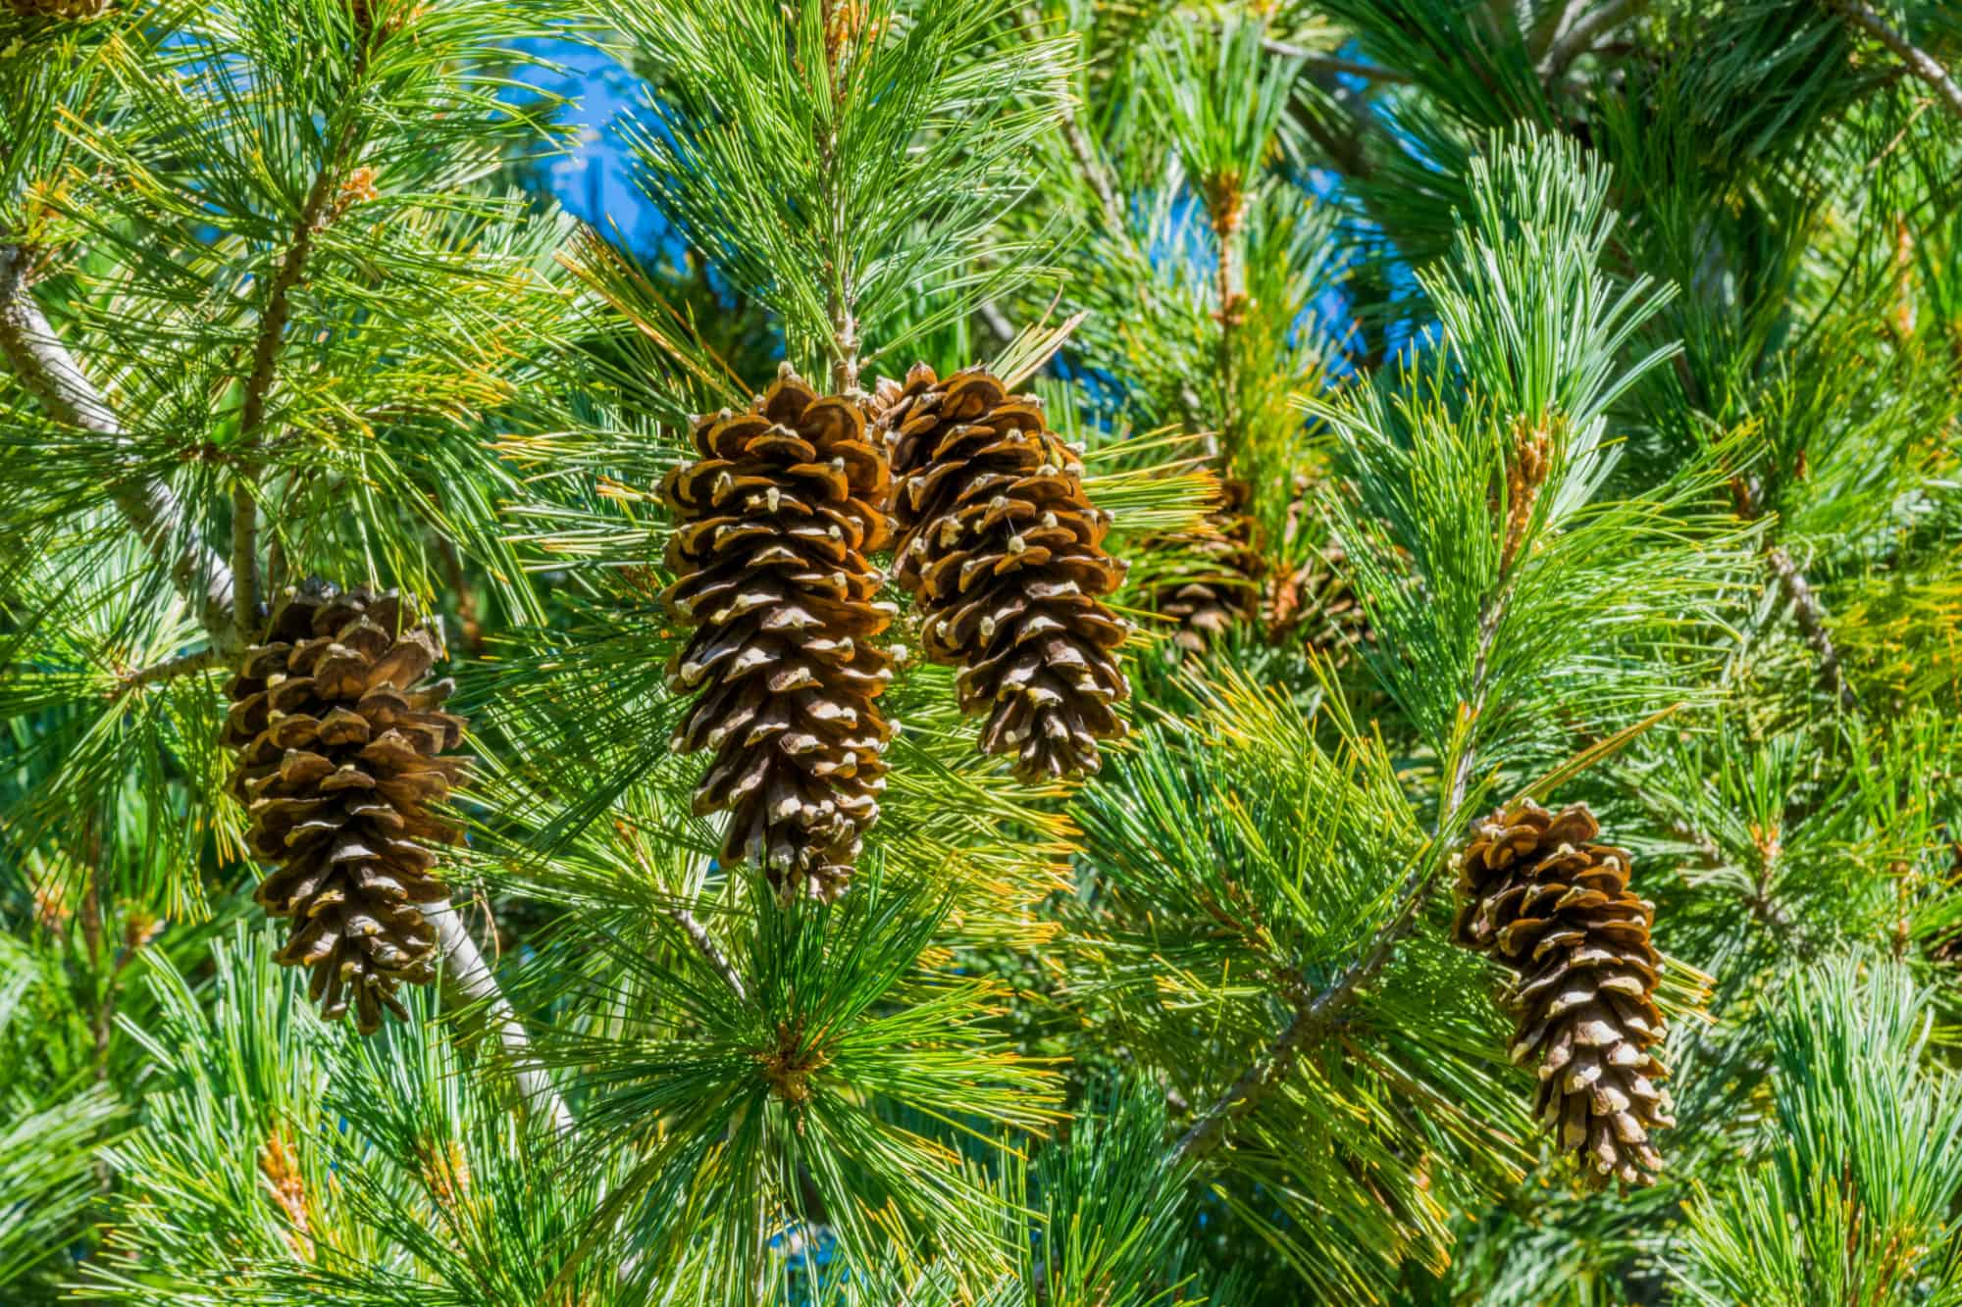
Non-flowering seed-producing plants (Gymnosperms)
Produce seeds but not flowers

Slide 7
Do processes like photosynthesis vary or differ with variations in plants?

Slide 8
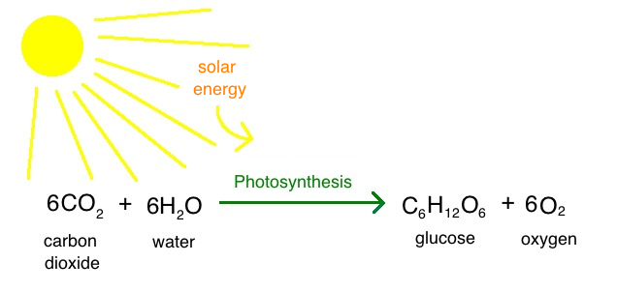
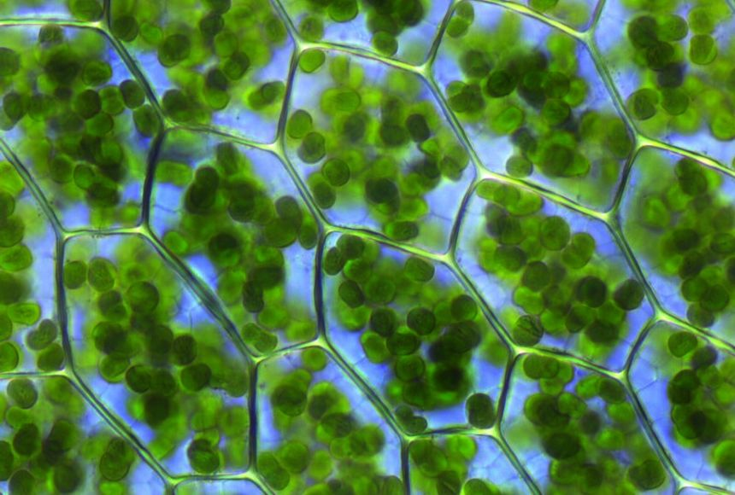

Chlorophyll or ‘green pigment’

Slide 9
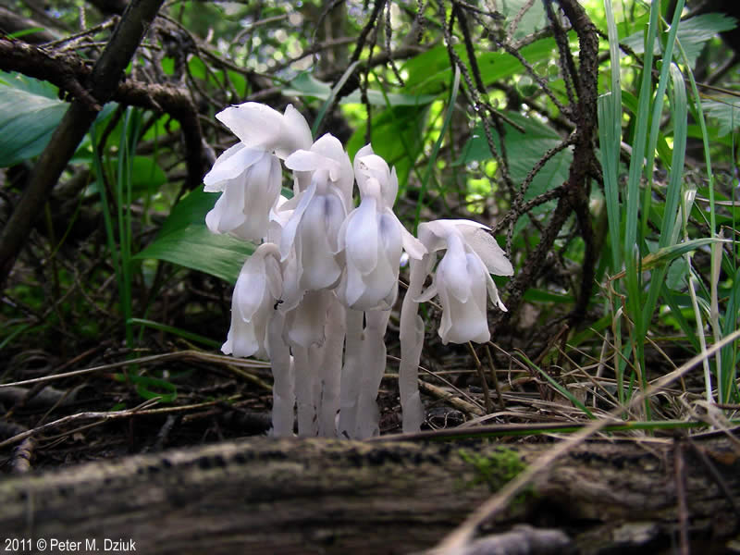
Ghost plant (Monotropa uniflora)
One of ~3000 plant species that don’t photosynthesize
‘Myco-heterotrophy’

Slide 10
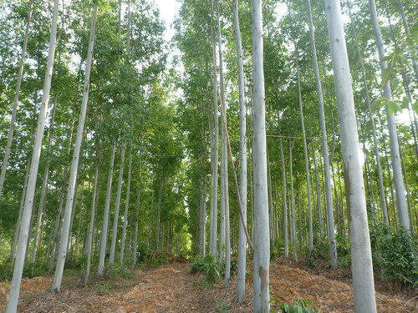
C3 plants tend to grow in cooler areas with less light

Slide 11
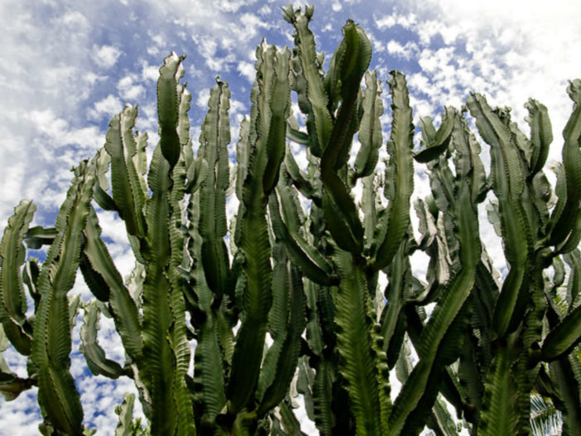
C4 plants tend to grow in areas with higher temperatures and more light

